Slide 1
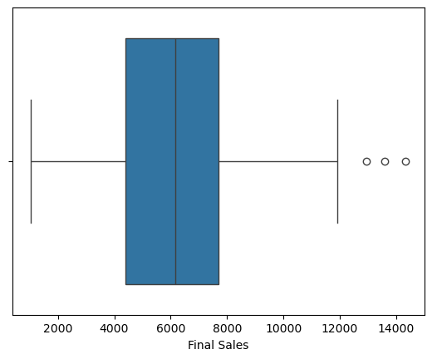
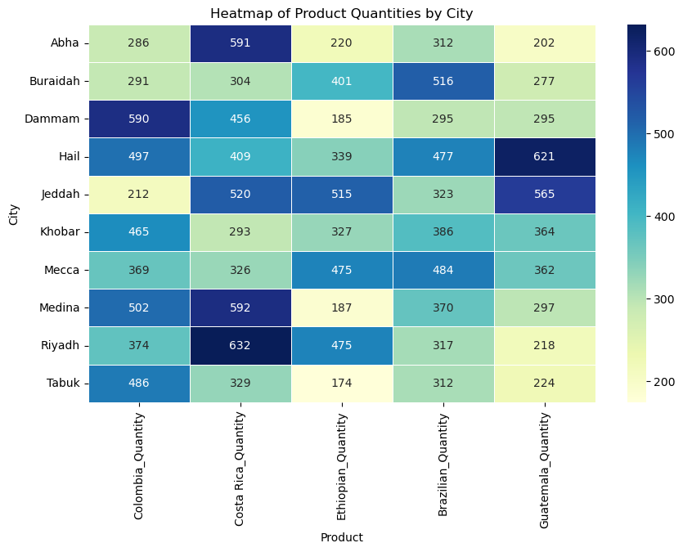
Coffee Bean Sales Project Data Summary
Executive Summary Report By Seungsoon Park
Project Overview
Seungsoon conducted a detailed analysis of coffee bean sales data in Saudi Arabia, identifying key variables and uncovering meaningful trends to provide actionable insights for the client.
Big Three Customers
CustomerID : 2, 82, 97
Found outliers of final sales
and this tells us that there are three customers who purchase more than other.
• City has difference preference of products such as, Guatemala for Hail and Costa Rica for Riyadh.
• Perform ANOVA test sales
amount by city and average
sales amounts of cities are the same with 95% of confidence level.
• Perform ANOVA test sales
amounts of products and
average sales amounts of
products are the same with
95% of confidence level
1.Check the trends of sales by years and month
2. Consider key variables for model
development

